Slide 1
00: 00004137 lui x2, 4 //load 16384 or 2 to power 14
04: 00711503 lh x10, 7(x2) (misaligned load address for halfword)
08: 00258593 addi x11, x11, 2
0c: 00851513 slli x10, x10, 8
10: 00a00963 beq x10, x0, 19 (misaligned instr address)
14: ff5ff0ef jal x1, -12
18: 00158593 addi x11, x11, 1
1c: 00158593
20: 00158593
24: 00158593
28: 00b175a3 sb x11, 11(x2) (illegal instruction, actual 00b105a3)

Slide 2
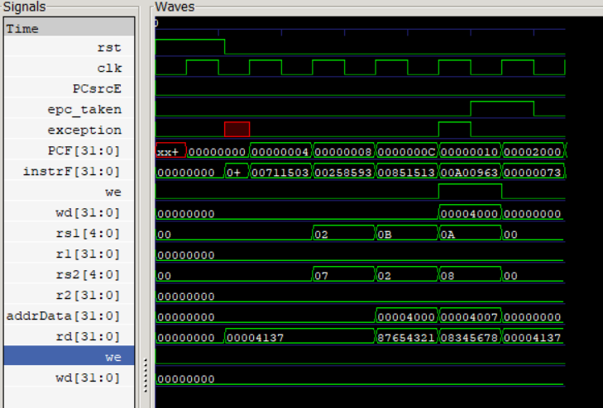

Slide 3
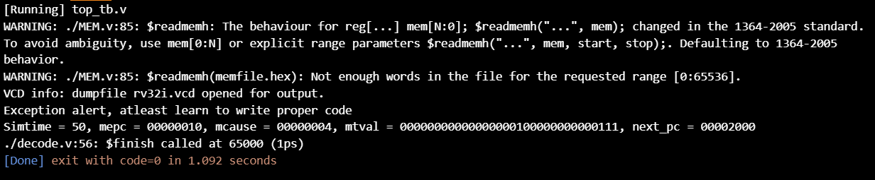

Slide 4
//fix load address at 04
00: 00004137 lui x2, 4 //load 16384 or 2 to power 14
04: 00611503 lh x10, 6(x2)
08: 00258593 addi x11, x11, 2
0c: 00851513 slli x10, x10, 8
10: 00a00963 beq x10, x0, 19 (misaligned instr address)
14: ff5ff0ef jal x1, -12
18: 00158593 addi x11, x11, 1
1c: 00158593
20: 00158593
24: 00158593
28: 00b175a3 sb x11, 11(x2) (illegal instruction, actual 00b105a3)

Slide 5
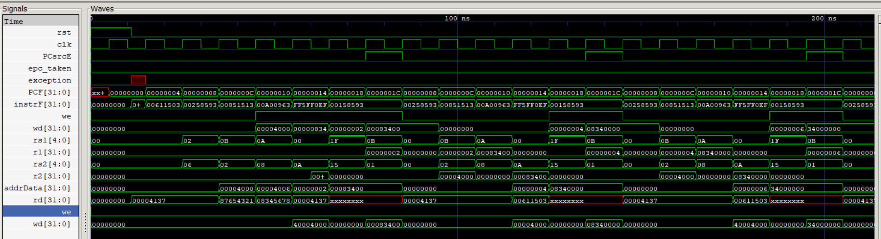

Slide 6
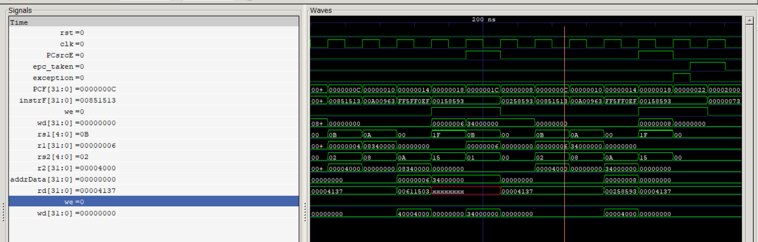

Slide 7
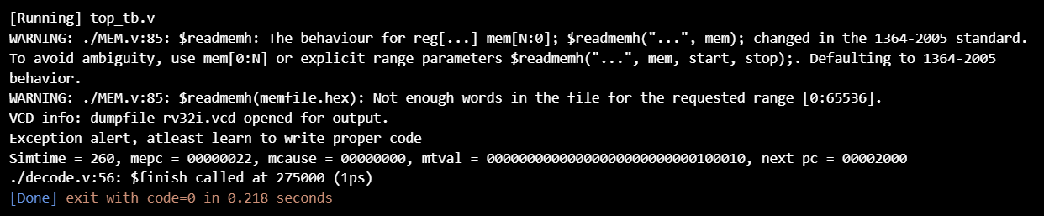

Slide 8
//fix branch adress at 10
00: 00004137 lui x2, 4 //load 16384 or 2 to power 14
04: 00611503 lh x10, 6(x2)
08: 00258593 addi x11, x11, 2
0c: 00851513 slli x10, x10, 8
10: 00050a63 beq x10, x0, 20
14: ff5ff0ef jal x1, -12
18: 00158593 addi x11, x11, 1
1c: 00158593
20: 00158593
24: 00158593
28: 00b175a3 sb x11, 11(x2) (illegal instruction, actual 00b105a3)

Slide 9
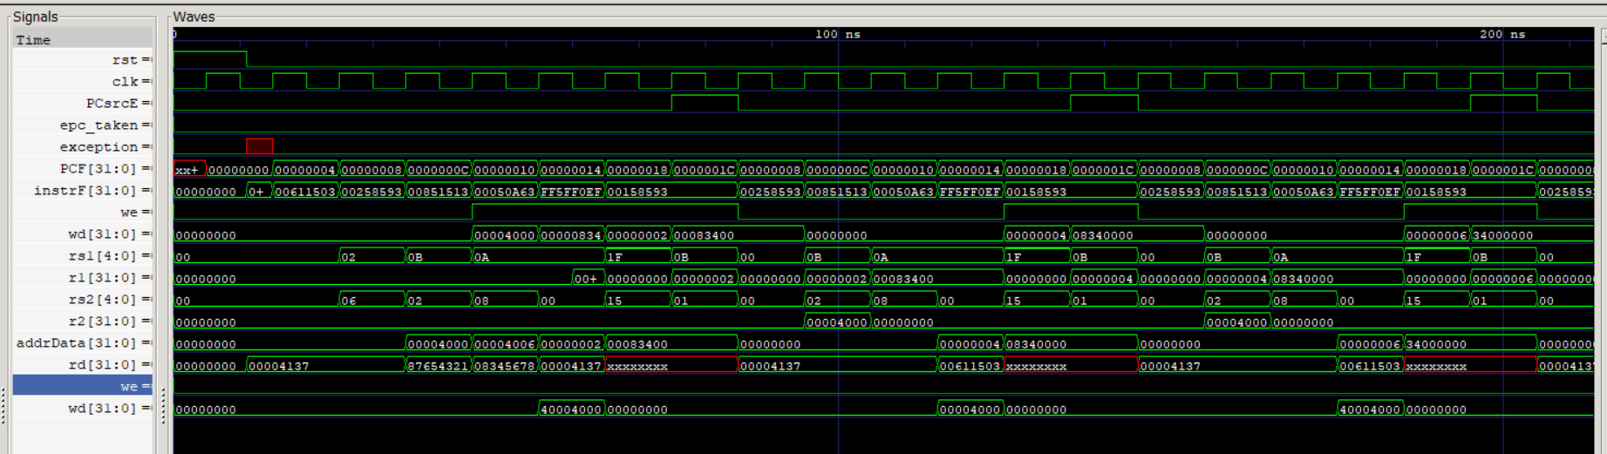

Slide 10
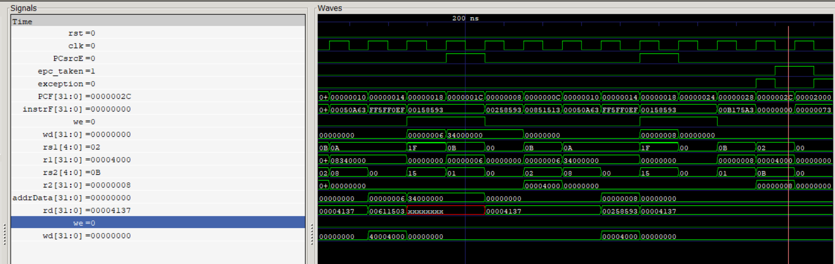

Slide 11
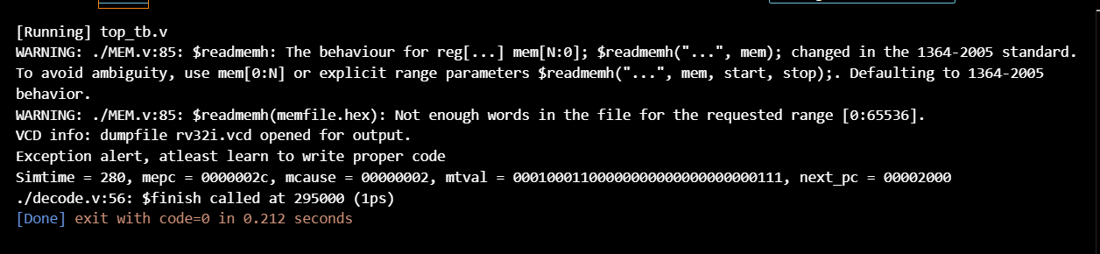

Slide 12
//working
00: 00004137 lui x2, 4 //load 16384 or 2 to power 14
04: 00611503 lh x10, 6(x2)
08: 00258593 addi x11, x11, 2
0c: 00851513 slli x10, x10, 8
10: 00050a63 beq x10, x0, 20
14: ff5ff0ef jal x1, -12
18: 00158593 addi x11, x11, 1
1c: 00158593
20: 00158593
24: 00158593
28: 00b105a3 sb x11, 11(x2)

Slide 13
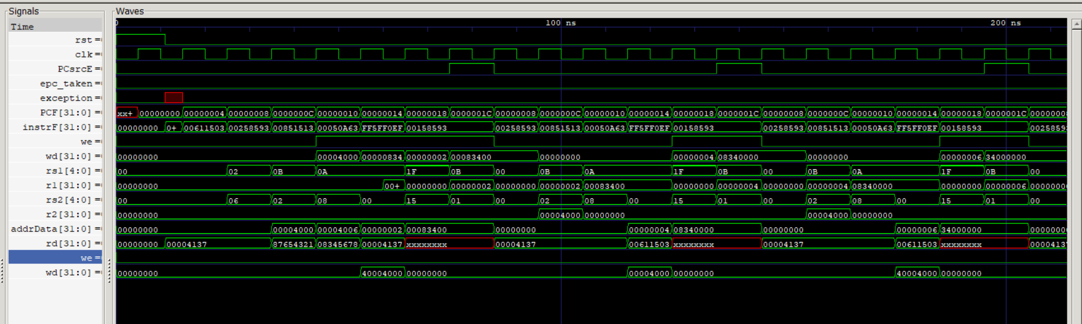

Slide 14
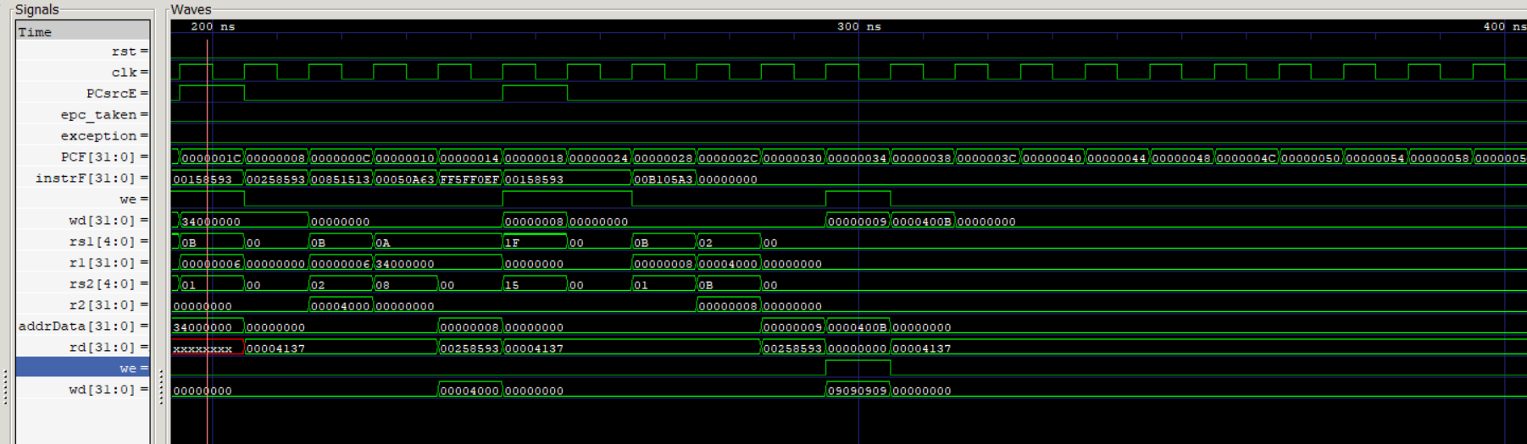

Slide 15
